Slide 1
3D Interactive Media Development
5MMCS001W Lecture 03a
Example of an immersive 3D UI
https://www.youtube.com/watch?v=gwYjnWCcw18
Notes:
https://www.slideshare.net/marknb00/comp-4010-lecture7-3d-user-interfaces-for-virtual-reality

Slide 2
3D Interactive Media Development
3DUI Interaction Practical examples
Quake 3 Web (js)
https://media.tojicode.com/q3bsp/
Mouse Look - Cursor Lock
Mouse Selection - State Switch from Cursor Lock
WASD Keyboard Navigation
Keyboard Interaction – State Changes

Slide 3
3D Interactive Media Development
3DUI Interaction Practical examples
Whitevoid
http://www.whitevoid.com/
Mouse Orbit – Selected object (Mouse Look vs Mouse Orbit?)
Mouse Raycast Selection of 3D object in 3D VE from 2D Screen
Animations triggered by Object Selections - Exploded view
Camera Waypoint Animation to 3D Object Selection – Mouse Orbit
Lowest level of selection frames and plays media

Slide 4
3D Interactive Media Development
3DUI Interaction Practical examples - extras
Interactive 2D CV
http://www.rleonardi.com/interactive-resume/
Narrative controlled by Mouse or Keyboard – Camera timeline
2D Diorama/Game Level
Collisions/timeline trigger animations
Web Links
Could be 3D with camera controls, object selection

Slide 5
3D Interactive Media Development
3DUI Interaction Practical examples
Practical Examples:
Exploded view
http://www.wilmotli.com/pubs/li08exview3D.pdf
https://www.youtube.com/watch?v=NL2QFLiM_mY
Exploded View – Car (Advanced)
https://www.youtube.com/watch?v=_i5RkAxGiwQ
Diorama Fragments
https://www.youtube.com/watch?v=Ty_hqTtvHdI
https://www.youtube.com/watch?v=5zmqZZshdfs
https://www.youtube.com/watch?v=U09hwnsUkY8
https://www.youtube.com/watch?v=iPEfHOCUVMI
https://www.youtube.com/watch?v=XmTRQml4Js0
https://www.youtube.com/watch?v=ErqpzWrQHAY
https://www.youtube.com/watch?v=meieYpHYTVU

Slide 6
Terminology
IVR – If VR is fully immersive with natural interactions, this meets the guidelines for full VR as set down by Brenda Laurel:
What is Virtual Reality?
https://medium.com/@blaurel/what-is-virtual-reality-77b876d829ba

Slide 7
Terminology
VR, VE – Virtual Reality and Virtual Environment:
These are somewhat synonymous, though the VE may not be as fully featured.
Virtual Reality is used indiscriminately and may not be accurate in all cases (360 video is sometimes incorrectly described as VR)
Virtual Reality is usually fully immersive

Slide 8
Terminology
AR – Augmented Reality involves enhancing a real world feed with virtual objects calibrated to the coordinate space.
On the Mixed Reality Scale, this can slide towards Augmented Virtuality – BBC Virtual News sets with real presenters

Slide 9
3DUI Applications
Simulation, Training, Education
Cultural Heritage, Tourism, Archaeology
Art ,Entertainment
Visualization - Architecture, Contruction
Visualization - Product Design, Prototyping
Medicine, Psychiatry
Communication, Collaboration, Social media, Telepresence

Slide 10
History
GUI
1973-1983 – Mouse, Keyboard, Raster Graphics, PCs
UI Design
HCI Studied
Perception
Cognition
Human Factors
Graphic Design

Slide 11
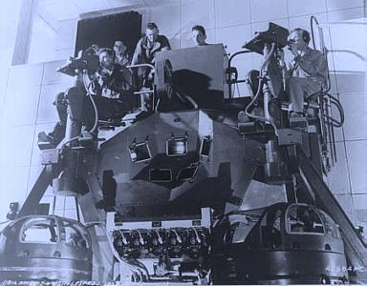
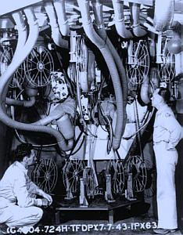
History
1940s
Fred Waller – First VR System – Military Tail Gunner Trainer
www.cineramaadventure.com/trainer.htm

Slide 12
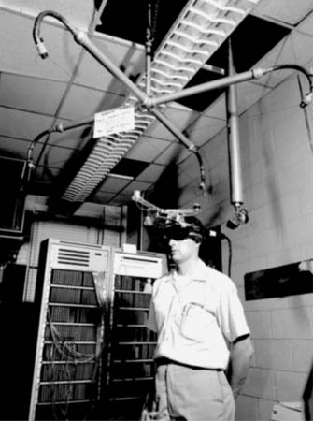
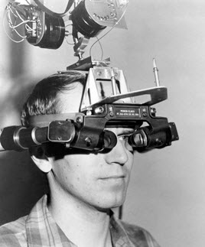
History
1960s
Ivan Sutherland – Head Tracked Head Mounted Display

Slide 13
History
1980s on…
Tracking and Mocap
Computer vision
Haptics
HMDs – Stereoscopy, FOV, FOR, Resolution and Refresh rate improved

Slide 14
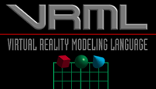
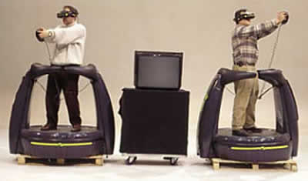
History – Platform Development
1990s on…
Web Browsers – VRML
Games – PC Graphics cards and GPUs drove development
Commercial and Military flight simulators
Augmented Reality from 2000 onwards
Mobile processor development
Smart Phone/ Tablet development - GPS, WiFi, Touch Controls, Front and Back mounted cameras, high speed processors
Arcade VR

Slide 15
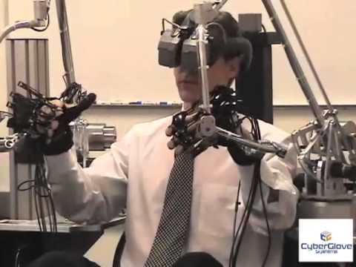
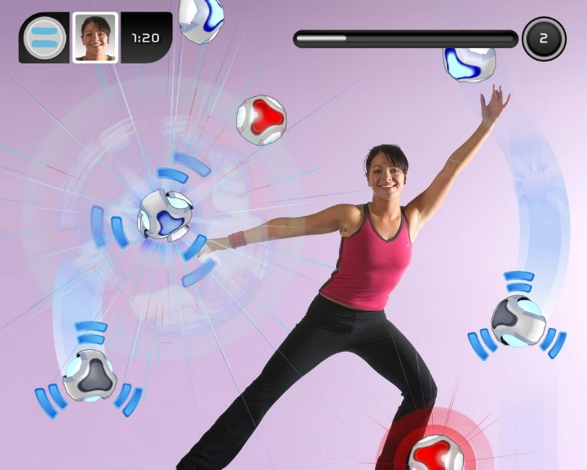
History – Platform Development
2000s on…
Commercial VR
Spatial Games Controllers
Wii
Sony eyeToy
Kinect

Slide 16
Current - Input Devices for VE
2D GUI
Mouse
Keyboard
Keyboards
Chording Keyboards
Virtual (Tablet) Keyboards
Custom hardware

Slide 17
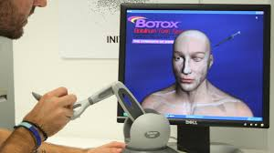
Current - Input Devices for VE
3D Motion Tracking – Input Devices
Razer Hydra – facebook VR
Haptic Pen - Botox
Magnetic sensors
3D Mouse - 3D Spacemouse – 6dof, no tracking
3D Motion Capture – Full Body or Part Body
Waldo
Gloves
Synertial
Cyberglove
Haptic Body Device
Cyber grasp

Slide 18
Current - Input Devices for VE
3D Sensors – Magnetic, Inertial, Accelerometer, GPS
Sensor Data
3dof – Orientation or Position only
6dof – Position and Orientation
Continuous Data or Discrete
Typical Uses
Head Tracker for POV, Parallax views, Fishtank VR, HMDs
Hands, Feet – Vtime Virtual Treadmill
Vive Paintbrush

Slide 19
Current - Outputs/Displays
Output/Displays…
Monitor – Mono and Stereo
Head Mounted Display – tracked head, stereo
Projected – Mono/Stereo, Cave
Retinal
Volumetric
Mobile Device – Smart Phone or Tablet, Can be used as a virtual window, and HMD in mono/stereo (Google Cardboard, Samsung GearVR), or a mobile “desktop”

Slide 20
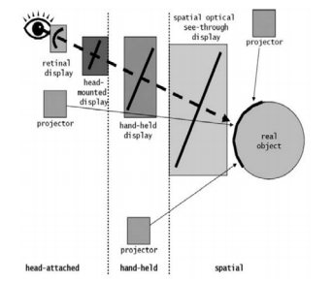
3D Interactive Media Development
3DUI Interaction Practical Considerations:
Output DeviceCan introduce third coordinate space to consider, along with VE and Input device
Range of Coordinate Spaces
(3D VE, 2D Display, Inputs)
Range of Viewpoints
Range of Software
Range of Input Devices
Range of Platforms
https://www.vs.inf.ethz.ch/edu/FS2013/DS/reports/AlexanderCebulla_ProjectionBasedAugmentedReality_report.pdf

Slide 21
3D Interactive Media Development
3DUI Interaction Practical Considerations:
Issues with Extra Dimension
3DUI needs Simultaneous Operations
The new Dimension brings freedom of movement
Coordinate Space Alignment
Scale, Registration
Input<>VE<>Output
Especially Problematic in AR
VE has Virtual Camera
Input has Real World POV + Scale
Output is varied and usually 2D
Tablet//Phone has In/Out Plane the same
2D into 3DVE
To be continued!

Slide 22
Current – Platform Development
Current:
Tablets
Mobiles
Desktops
3D and Haptics inputs
Integrated HMD
HoloLens, Google cardboard, Oculus Rift, Vive
Some Spatial games controllers
Vive, Oculus Touch
Cave
Hybrid

Slide 23
Current State of Technology
Tablet/Smartphone
Mobile CPU/GPU
Broadband connectivity
Input and Output in same screen
Input
Virtual Keyboard
Touch Input
Accelerometer
GPS
Output
Direct 3D Interaction through 2d Screen
Virtual Window for AR
Can augment further 3DUI – Virtual Menus

Slide 24
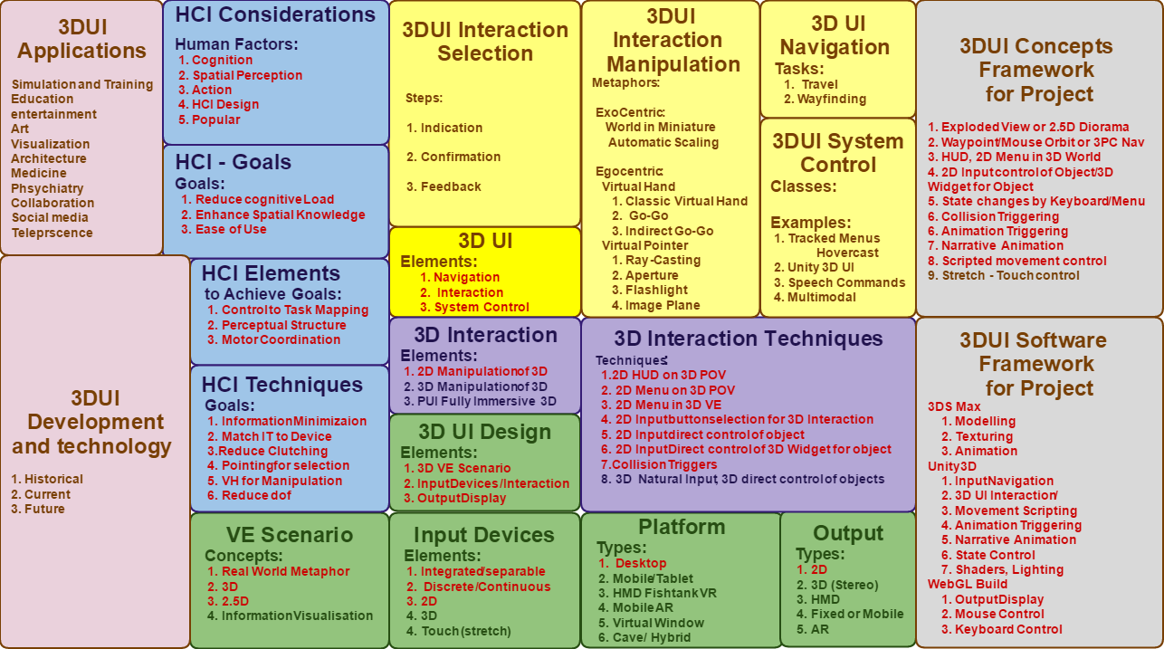
3DUI Framework Chart

Slide 25
3DUI - Basic Elements
Basic Elements to consider and Plan
Navigation
Travel
Point of View - POV
Interaction
Selection
Manipulation
System Control
States
Modes of Interaction

Slide 26
3DUI - Navigation
Basic Elements to consider and Plan
Navigation
The most common VE task, and is actually composed of two tasks.
Travel is the motor component of navigation, and just refers to the physical movement from place to place.
Wayfinding is the cognitive or decision making component of navigation, and ask the questions “Where am I”, ”Where do I want to go”, ”How do I get there”…

Slide 27
3DUI - Navigation
Basic Elements to consider and Plan
Navigation
Travel
Point of View – POV
Examples:
WASD
Pointing – Travel and gaze in different directions
Arrows
Mouse Look/orbit
Clutching, Waypoints, Grabbing and Pulling
Paired with Locomotion devices – Vtime Treadmill

Slide 28
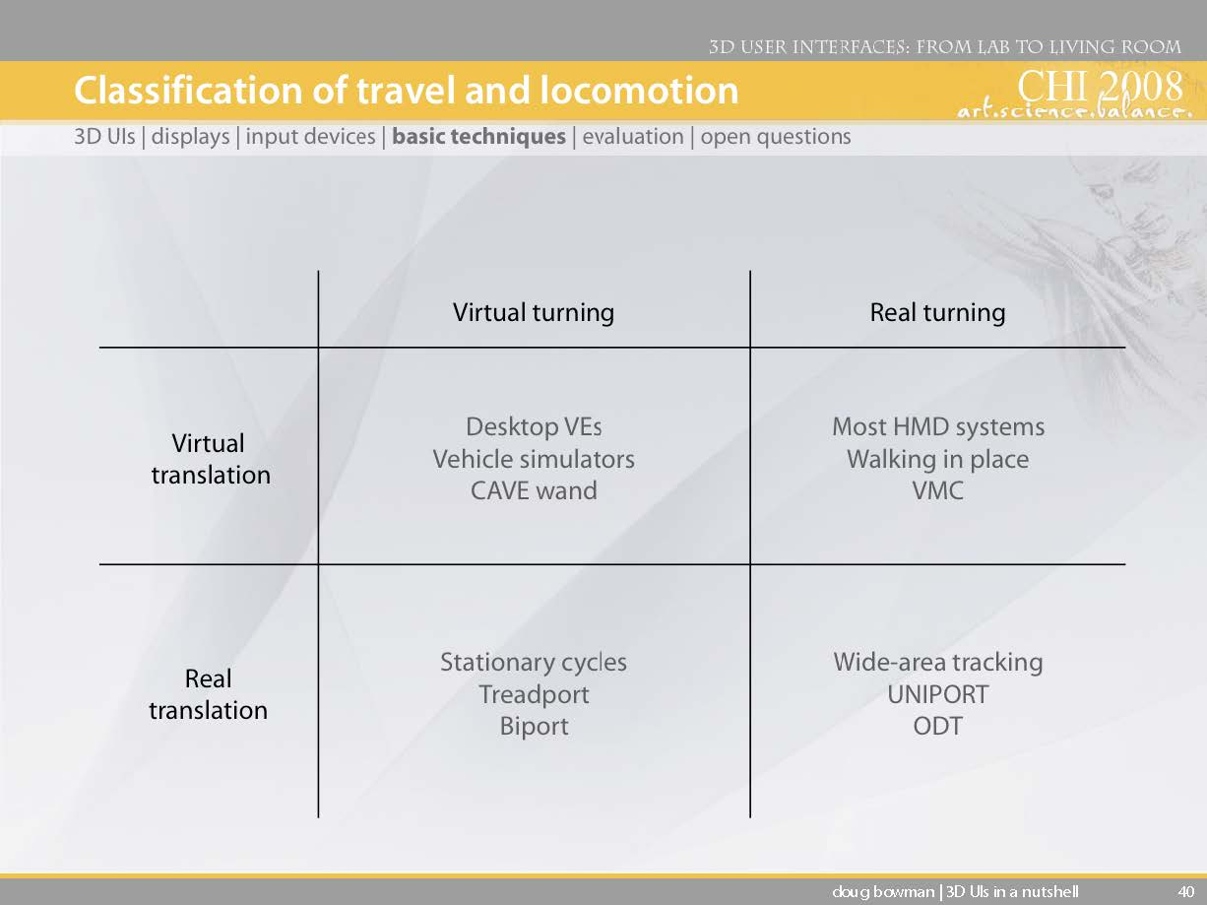
3DUI – Navigation Classes

Slide 29
3DUI – Navigation Tips
Travel should be simple:
Low cognitive load
Target based to object
Steering for search
Provide multiple techniques for multiple tasks
Use graceful transitions
Separate gaze from travel – permanent or switchable
Quake WebGL
//media.tojicode.com/q3bsp/

Slide 30
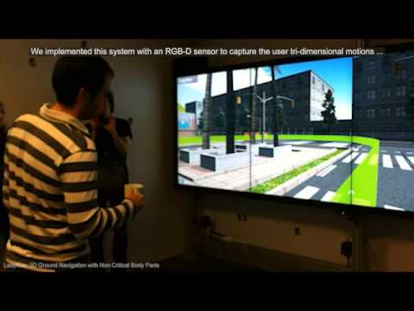
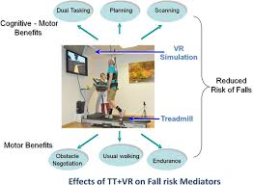
3DUI – Navigation
Reverie – lazynav
https://youtu.be/hL5mQcCFU9I
Vtime Treadmill

Slide 31
3DUI - Basic Elements
Basic Elements to consider and Plan
Interaction
Selection
Simply the specification of an object or
set of objects for some purpose.
Manipulation
Refers to the specification of object properties (most often position and orientation, but also other attributes). Selection and Manipulation are often used together, but selection may be a stand-alone task. For example, the user may select an object in order to apply a command such as delete to the obj.

Slide 32
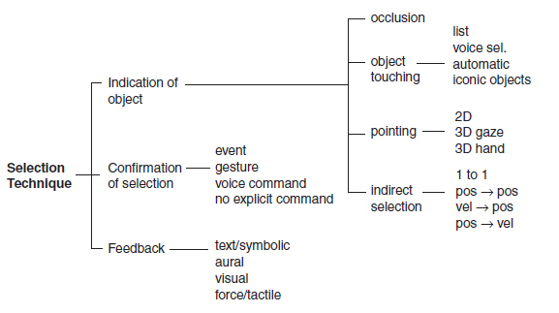
3DUI - Selection

Slide 33
3DUI Selection Techniques
Virtual Hand
Raycasting/Occlusion
Go-Go arm extension

Slide 34
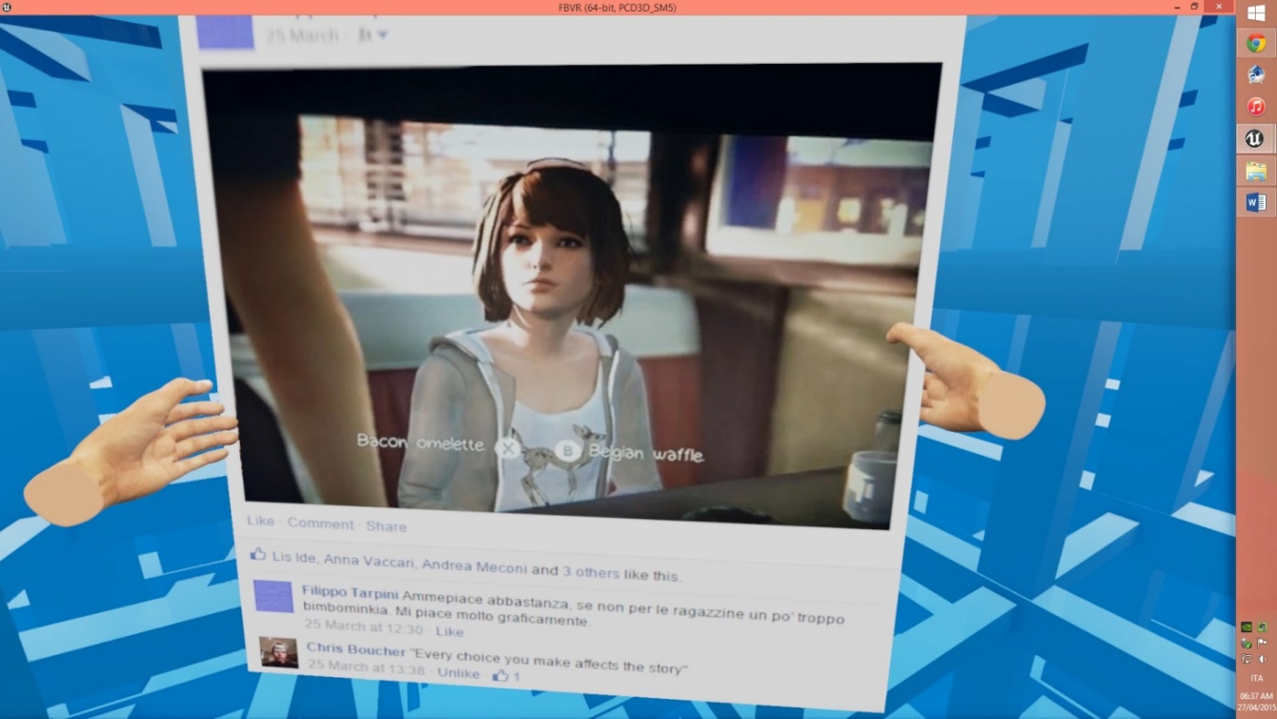
3DUI - Selection
Simple Virtual Hand
Object is Selected by collision, made child of mapped VH, then released.
Natural one-to-one mapping between Physical and Virtual hands.
Kinect is a good example of use.
Direct Mapping and touching of objects.
Can only select objects within Physical hand reach.
Razer VR +
Facebook VR

Slide 35
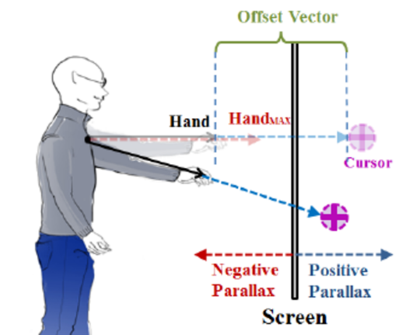
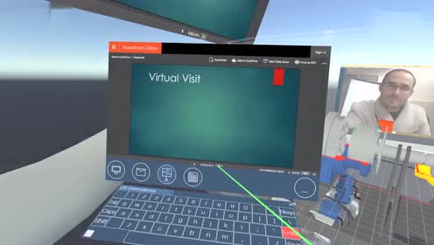
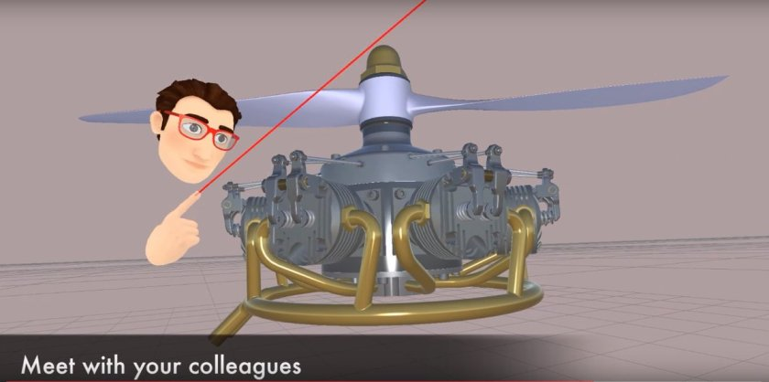
3DUI - Selection
RayCasting
Virtual Hand or Mouse Laser Pointer
Laser pointer attached to Physical hand
Ray is cast into the 3D VE from 3D input or 2D Plane (Screen)
First object intersected is selected
Made by only 2 dof (pitch and yaw)
Efficient - Mouse or touch
Limitation of 3rd dof works well for remote selection
Also cone casting and snap to object rays
High performance
Occlusion
Works in image plane (tablet, mobile)
Covers it to select – ray from eye to nearest object through finger

Slide 36
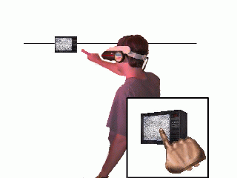
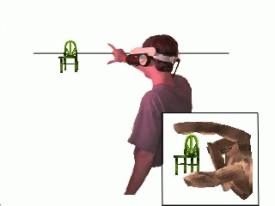
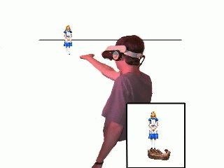
3DUI - Selection
Occlusion
Works in image plane (tablet, mobile)
Covers it to select – ray from eye to nearest object through finger
Sticky finger, head crusher, palm lifter
http://www.cs.cmu.edu/~stage3/publications/97/conferences/3DSymposium/HeadCrusher/

Slide 37
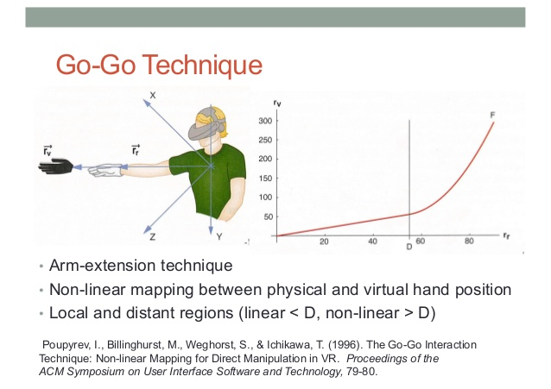
3DUI - Selection
Go Go Arm Extension
Virtual Hand
Non one-to-one mapping
Requires 3dof

Slide 38
3DUI - Selection
Increase selection area:
Cone casting
Snapping
3D Bubble cursor

Slide 39
3DUI - Selection
Other
Multimodal – Eye Tracking and Speech select
https://repository.royalholloway.ac.uk/file/c4d1a84d-d4d4-a856-b25a-331dd40dedbe/8/Murtagh-Eye_movements_and_voice.pdf

Slide 40
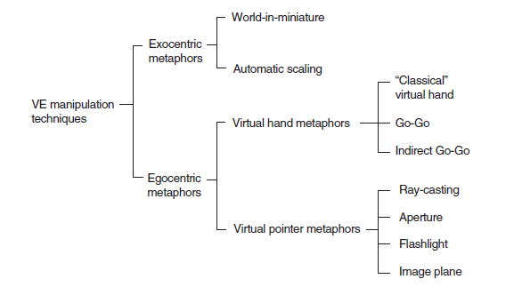
3DUI - Manipulation

Slide 41
3DUI - Manipulation
Exocentric Metaphors
World In Miniature – Dollhouse manipulated in hand
Automatic Scaling – Selection scales objects to user
Ego Centric Metaphors
Virtual Hand Metaphors
Classic Virtual Hand – Isomorphic, Direct Mapping
Go-Go – VH but nonilinear mapping
Indirect Go-Go – Raycasting
Virtual Pointer Metaphors
Ray-Casting, Occlusion – Laser Pointer, Finger Cover
Aperture - Peephole
Flashlight – Cone Selection
Image Plane

Slide 42
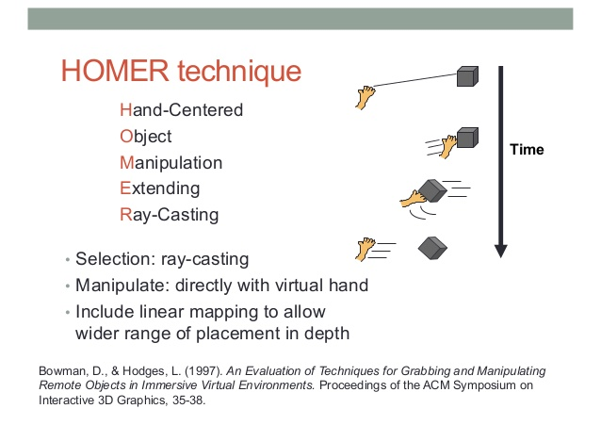
3DUI - Manipulation
HOMER
hand object manipulation extending raycasting - Linear

Slide 43
3DUI - Manipulation
Go-Go (Indirect Go-Go)
Moves VH to Object to manipulate – Non-Linear
(ray casting) Like Waypoint and Mouse orbit, but for object rather than camera

Slide 44
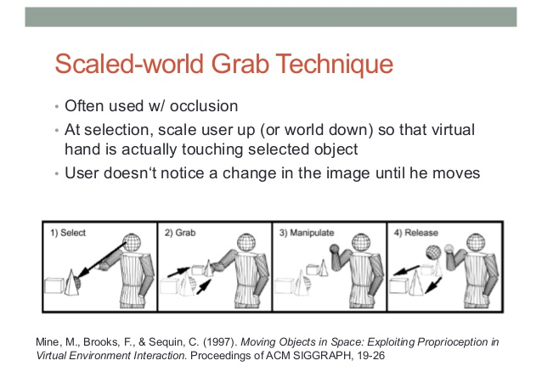
3DUI - Manipulation
Scaled World Grab
Used with Occlusion selection – Image Plane
Scaled to directly adjust like Virtual Hand

Slide 45
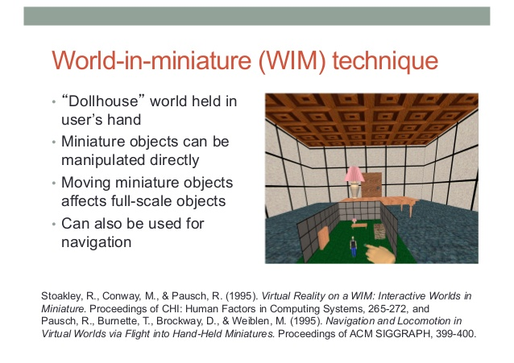
3DUI - Manipulation
WIM – World In Miniature – dollhouse or game map
Map that has effect on VE
Manipulate items and navigation in small area.

Slide 46
3DUI - Manipulation
Typical for this project:
2D Interface controls for 3D Manipulation - Button or Slider
3D Widget – direct object manipulation tools
State Buttons or sliders – Time(Narrative), Materials
Look at Vizor.io:
https://www.youtube.com/watch?v=n1g9QaKe7rU

Slide 47
Terminology – 3D UI Widgets
3D UI: Menus and 3D interaction Widgets in Vizor.io
https://www.youtube.com/watch?v=_FvWtFyeNss&list=PLL0Qt-QS9kmTNhmYOMOvy0XMyvzdAdFnX
2D HUD on 3D POV
2D Menu on 3D POV
2D Menu within 3D VE
2D mouse selection of button for 3D Interaction
2D mouse direct control of object
2D mouse direct control of 3D Gimbal/Widget for object
3D Natural Input and 3D direct control of objects

Slide 48
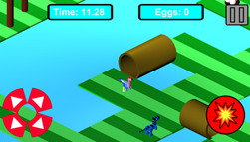
3D Interactive Media Development
3DUI Interaction Widget examples
Practical Examples:
2D Joystick Widget
https://www.youtube.com/watch?v=nGYObojmkO4

Slide 49
3DUI Interaction - Example
Multimodal Example – Historical - 1980
Put That There
https://www.youtube.com/watch?v=sC5Zg0fU2e8

Slide 50
3DUI Interaction – Manipulation Tips
Match Interaction Technique to Device
Reduce Clutching
Use Pointing Techniques for Selection
Best Control to task Cognitive Map
Use Virtual Hand Techniques for Manipulation – (extra)
Best Control to task Cognitive Map
Reduce dof if Possible
Clamp extra dimension to 2.5D or Orthographic
Limit free movement in extra dimension

Slide 51
3DUI Interaction – System Control
Basic Elements to consider and Plan
System Control
The task of Changing the System State or Mode of Interaction.
This is usually done with some type of command to the system
Examples:
2D
Menus
Command Line
Can Involve selection, manipulation, etc. ..
…but best to consider it separately

Slide 52
3DUI Interaction – System Control
System Control Techniques
Virtual Menus –Unity3D UI
Tool Selectors – metaphors
Speech Commands (Multimodal)
Pen and Tablet
For CW
Just need Selection technique
Use good Visual Feedback
Use menus, tabs, buttons, widgets and other systems for higher marks
Let the ideas drive the interaction

Slide 53
3DUI Interaction – System Control
System Control Techniques
Unity 3D UI
https://www.youtube.com/watch?v=QxRAIjXdfFU
Essentially similar to Immerse
https://www.youtube.com/watch?v=gwYjnWCcw18
Notes:
Hovercast Menus
https://www.youtube.com/watch?v=Phn3Ix-YxPA
Will Steptoe https://youtu.be/Bc_TCLoH2CA

Slide 54
3DUI Interaction -System Control Tips
System Control Tips
Don’t Disturb Flow of Action
Use Correct Spatial Reference
Allow for Multimodal
Structure Functions
Give Good Feedback

Slide 55
3DUI Applications
Simulation, Training, Education
Cultural Heritage, Tourism, Archaeology
Art ,Entertainment
Visualization - Architecture, Contruction
Visualization - Product Design, Prototyping
Medicine, Psychiatry
Communication, Collaboration, Social media, Telepresence

Slide 56
3DUI Unity
Screen Capture Software
Any Issues?
Start to think about Unity UI
https://www.youtube.com/watch?v=JrlFMwLI1fw
https://unity3d.com/learn/tutorials/topics/user-interface-ui
https://blogs.unity3d.com/2014/06/30/unity-4-6-new-ui-world-space-canvas/

